Slide 1
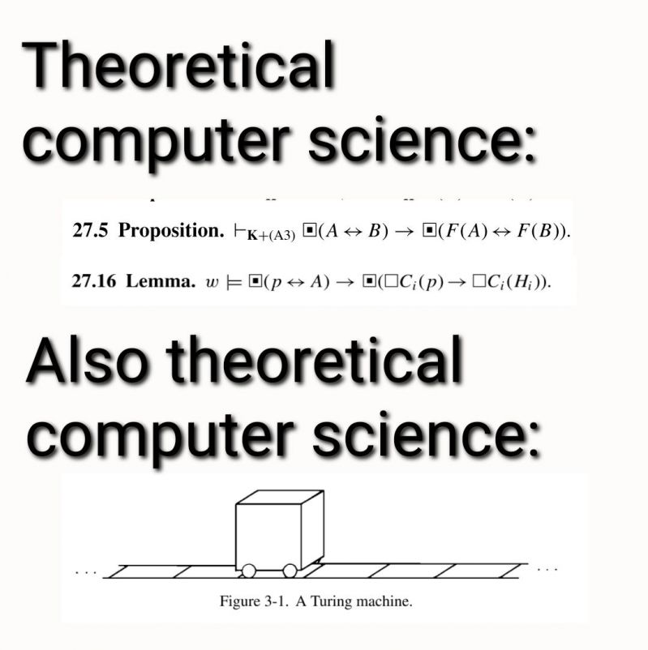

Slide 2
Lecture 3.2: Dynamically Allocated Memory
CS2308
Gentry Atkinson

Slide 3
Statically Allocated Memory
Think about a program that needs 3 integers and an array that holds 12 characters.
That program’s variable will occupy 24 bytes of memory every time it runs, no matter what.
Static allocation is easy to use but can only hold a fixed amount of information.

Slide 4
Dynamic Memory Allocation
Some programs need to be able to change the amount of information they are storing.
Think about a High Score list:
  static allocation: only store the 10 highest scores
  dynamic allocation: store all scores and show them in an ordered list.

Slide 5
The new keyword.
Used to allocate memory at run time.
Returns a pointer to the new memory location.
Can be used to allocate memory for any datatype: primitive, user defined, scalar, or array.

Slide 6
Example 1
int main(int argc, char** argv){
int * p = new int;
*p = 8;
cout << *p << endl;
} //try to predict the output

Slide 7
Memory Management
Statically allocated memory gets automatically “cleaned up” when it’s no longer in use.
Dynamically allocated memory is not automatically freed.
The delete keyword is used to release memory that has been dynamically allocated.

Slide 8
Example 2
//This function "leaks" 4 bytes of memory every
// time it runs.
void leakyFunc(){
int* p = new int;
*p = rand();
cout << *p << endl;
}
int main(int argc, char** argv){
for(int i = 0; i < 1000; i++)
leakyFunc();
} //try to predict the output

Slide 9
Example 2.5
//This function de-allocates its memory
void notLeakyFunc(){
int* p = new int;
*p = rand();
cout << *p << endl;
delete p;
}
int main(int argc, char** argv){
for(int i = 0; i < 1000; i++)
notLeakyFunc();
} //try to predict the output

Slide 10
Garbage Collection
Allocated memory that cannot reached by a pointer is called “Garbage”.
Removing wasteful garbage from memory is called garbage collection.
Some languages have automatic garbage collection but not C++.

Slide 11
Allocating Arrays
We can create arrays of any size dynamically at runtime.
The new keyword is used for this too.

Slide 12
Example 3
int main(int argc, char** argv){
int * arr = new int[10];
arr[5] = 2;
cout << arr[5] << endl;
return 0;
} //memory leak!

Slide 13
De-allocating Arrays
Arrays have to be cleaned up just like any other dynamically allocated memory.
Use [square brackets] following the delete keyword to delete the whole array, not just the address pointed to.

Slide 14
Example 3.5
int main(int argc, char** argv){
int * arr = new int[10];
arr[5] = 2;
cout << arr[5] << endl;
delete [] arr;
return 0;
} //nice and tidy!

Slide 15
Returning Pointers from Functions
Dynamically allocated memory is not automatically freed when it goes out of scope.
Pointers to dynamically allocated memory can be returned from functions (sorry Unit 3.1).

Slide 16
Example 4
int* makeArr(){
int*p = new int[10];
for(int i = 0; i < 10; i++) p[i] = i;
return p;
}
int main(int argc, char** argv){
int * arr = makeArr();
cout << arr[0] + arr[1] << endl;
delete [] arr;
} //try to predict the output

Slide 17
Using Dynamically Allocated Memory
We can use DAM to:
  Make arrays that grow as we add items.
  Use arrays of pointers to stores large collections of structs.
  Make quasi-2D arrays where each row has a different length.

Slide 18
Questions or Comments?

